Slide 1
Transportation
2022-2023
April 13, 2022

Slide 2
Transportation Workgroup Members
Teachers
Principals
Students
Parents
School Board Members
Community Partners
Central office staff from special education, secondary activities, and transportation

Slide 3
SPS Transportation Team
Rebecca Doughty
-Executive Director of School Supt Services
Corey Arkle
-Transportation Supervisor
Michael Warnecke
-Transportation Specialist Lead (General Education)
Dani Galvez
-Transportation Specialist Lead (Special Education)

Slide 4
Purpose
School districts across the nation are having to evaluate their transportation models and service options due to the national bus driver shortage.
Evaluate options to improve transportation for the upcoming 2022-2023 school year to ensure all students are arriving to school or their activities safely and on time.
Develop a plan to ensure a more successful school year for students and minimize the potential learning minute loss that could result from transportation challenges.
Identify long-term strategies for further exploration and the respective implementation timelines.

Slide 5
At a Glance
Spokane Public Schools contracts with Durham School Services to transport:
850 special education and 12,000 general education eligible daily student riders.
Average 1,350+ McKinney-Vento eligible students each school year.
9,000+ miles traveled daily.
Current total student enrollment is 29,000+. We transport an average of 35% of our total student population.
Prior to 2020 Durham had 150-158 school bus routes and averaged 170 route drivers.
Durham currently has 91 school bus routes and 85 route drivers.

Slide 6
Short-term Strategy Recommendations
Increase efficiencies of routes.
Changing bus arrival times before & after school to provide more time between tiers.
Increased walk boundary from 1.0 mile to 1.5 mile for MS & HS.
Increased high school student ridership through STA partnership.
Evaluating current additional bus service options with alternatives.

Slide 7
Strategy 1A: Increase Efficiencies of Routes
Centralized Area Stops
Reducing the number of neighborhood stops and creating more centrally located gathering locations deemed safe and accessible. Reducing the number of stops (i.e., Chase currently has 51 stops).
Students residing within the current 1.0 mile walk boundary average a walk distance of 0.6 miles to and from school.
Students eligible for a school bus walk an average of 0.2 miles to get to and from a bus stop.
Increasing walk-distance to stops to 0.5 miles will eliminate underutilized stops, increase efficiency and on-time arrival.

Slide 8
Strategy 1B: Increase Efficiencies of Routes
Enhance Bus Registration Process
Communicating the need to register for transportation services before the current school year ends.
Reinforcing early transportation registration helps to better plan the bus routes for the upcoming school year.

Slide 9
Strategy 2: Extending Bus Arrival Times
Permitting more time between drop-offs in the morning and pick-ups in the afternoon will allow buses to pick up more riders, be safer, and improve on-time arrivals.
Benefits:
Allows for routes to better utilize available capacity per bus.
Better on-time arrival.
More efficient routes.
Considerations:
Impact to schools and community must be evaluated.
May require increased supervision at the schools. Staffing could be a challenge.

Slide 10
Strategy 2: Extending Bus Arrival Times
Changes time between tiers from 10-20 min to 30-40 min

Slide 11
Strategy 3: Walk Zones
Existing policy
Students for all grade levels living beyond a 1.0-mile radius from their neighborhood school are eligible for transportation.
Transportation is also provided to students K-12 who live within the specified 1.0-mile radius but whose travel is impeded by a hazardous area.
*The requirements differ for special needs students with transportation as a related service.

Slide 12
Strategy 3: Walk Zones
Expanding Walk-Zone radius for Middle and High School students
Elementary walk-zone distance would remain 1.0-mile.
Expanding the walk-zone distance from a 1.0-mile to a 1.5-mile radius for MS & HS.
Benefits:
Fewer riders would reduce route count.
Allow consistent service to those that really need a yellow bus.
Can continue transportation for all 3 tiers.
Considerations:
Community buy-in.
New Hazardous areas would need to be identified.
May need to hire more crossing guards in some areas. Staffing could be a challenge.
Inclement weather conditions.

Slide 13
Strategy 3: Walk Zones
Comparable District Walk-Zone Distances
Seattle Public Schools
1 mile for elementary students
2 miles for middle school students
2 miles for High School students (Transit cards provided for those not in SPED or HEART)
Kent School District
1.34 miles for elementary students
1.75 miles for middle school students
2 miles for high school students
Bethel School District
1 mile for elementary students
2 miles for middle school students
2 miles for high school students
Beaverton School District (OR)
1 mile for elementary students
1.5 miles for secondary students
Boise and West Ada School Districts (ID)
1.5 miles for all grade levels
Carpentersville School District (IL)
1.5 miles for all grade levels

Slide 14
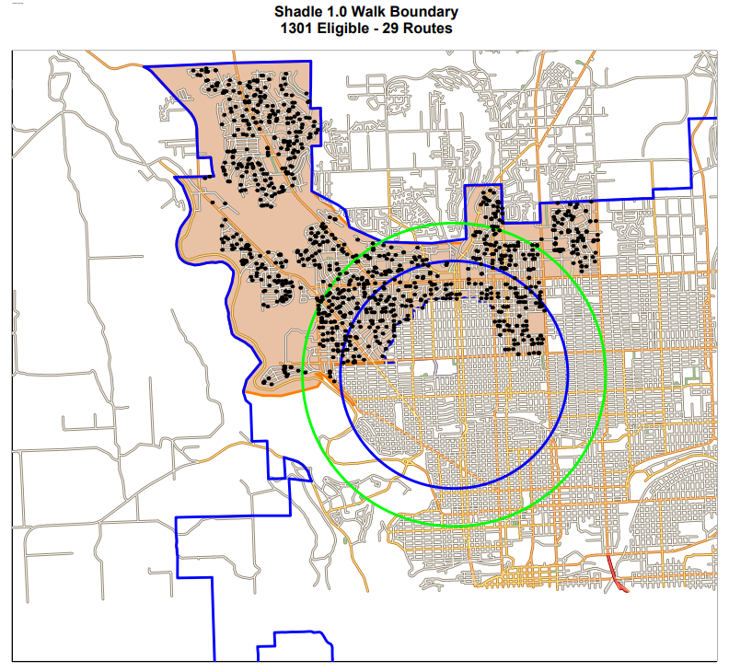
Example

Slide 15
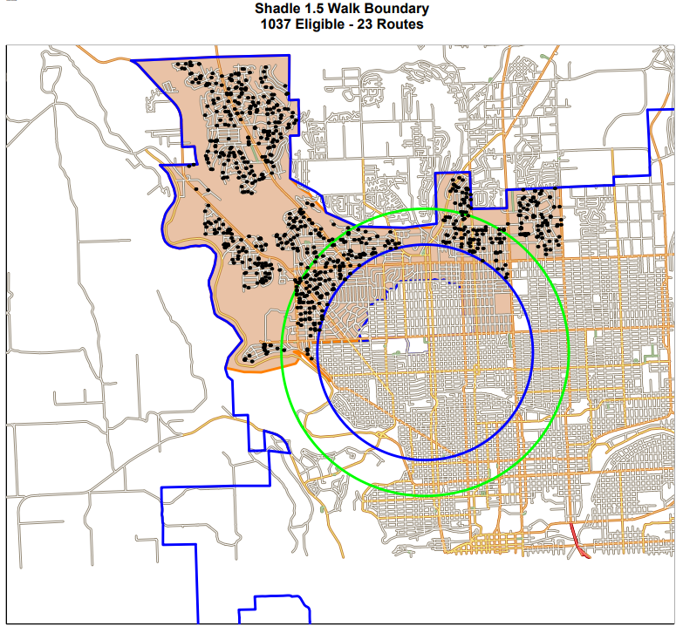
Example

Slide 16
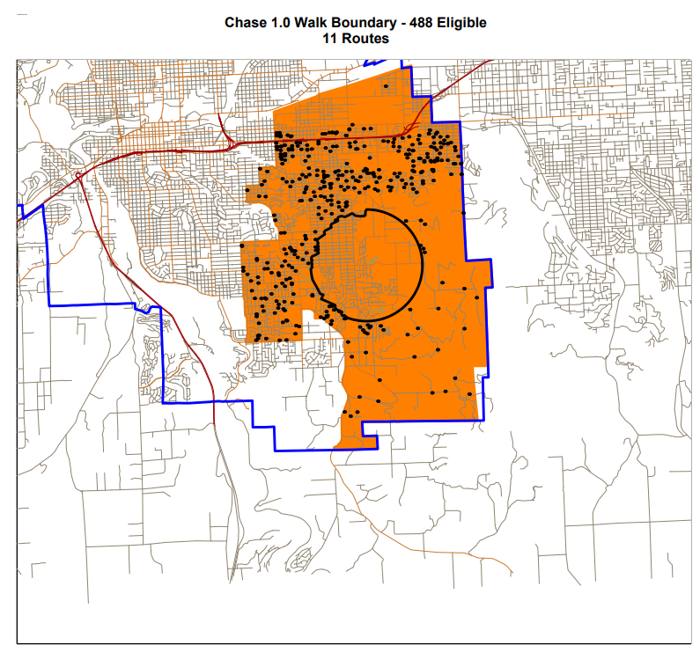
Example

Slide 17
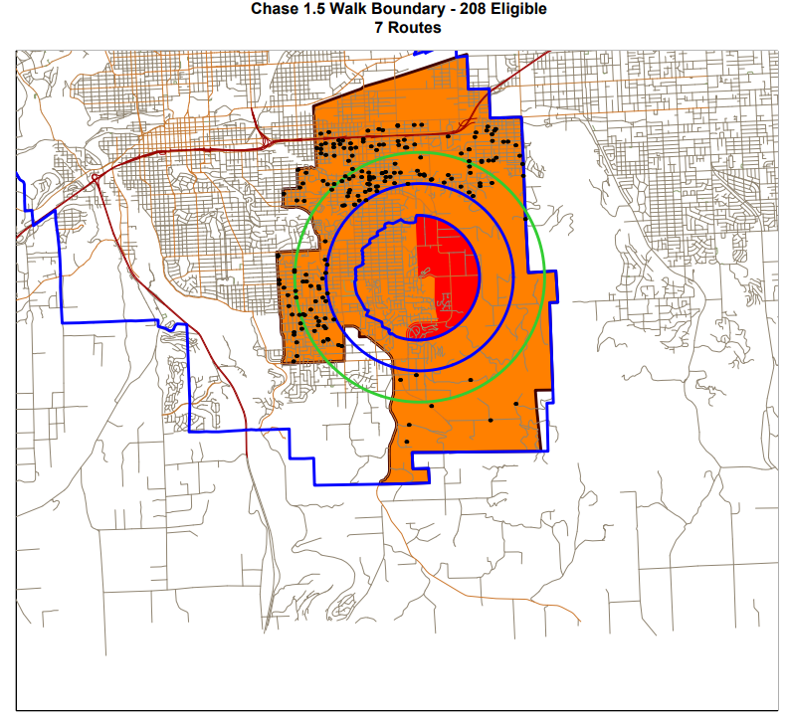
Example

Slide 18
1.5-Mile Walk Boundary GenEd Busing Impacts

Slide 19
Strategy 4: Partnership with STA
Provide as many eligible high school student riders with an STA bus pass for their transportation.
Benefits:
Every High School is currently served by 1 or more STA routes.
More consistent transportation for many students.
Can be used during non-school days and hours.
Considerations:
Some neighborhoods do not have easy access to existing STA stops or service.
Would reduce ridership for High Schools only.
Parameters for student tracking, safety, and ridership rules would need to be established with STA.

Slide 20
Strategy 5: Explore alternative transportation options for students in these programs
Choice Programs – To include Libby, Montessori, Tessera, IST, Pratt Academy, Apple. Currently using hub stops, servicing the entire district.
Excelsior – Extended ride times due to students coming from across the entire district. Location is not centrally located.
Express – Shuttled between elementary schools.
Early Learning/CAPE – Only attends 4 days per week, calendars don’t always match district calendar.

Slide 21
Short-term Strategy Recommendations Recap
Increase efficiencies of routes.**
Changing bus arrival times before & after school to provide more time between tiers.***
Increased walk boundary from 1.0 mile to 2.0 mile for MS & HS.***
Increased high school student ridership through STA partnership.**
Evaluating current additional bus service options with alternatives.*

Slide 22
Long-term Recommendations
Evaluation of contractor proposals and contract models.
  2022-2023 final year of the current transportation contract.
More extensive partnership with STA (Changes in legislation for 2023).
Full or Partial In-house Transportation.
  Co-op model with surrounding districts if partial or full in-house.

Slide 23
Questions?

